Slide 1


GIT

Slide 2

Git Intro
Git: A Version Control System.
The most popular nowadays.
Industry standard to project development.
Allows to always have a cloud copy of the project.
Allows several developers to work at it at the same time
Allows to coordinate the changes across the different lines that developers had been working on.
Keeps track of the changes, allowing to go back to them if needed.
Allows to show the whole project history, not only the latest changes

Slide 3
Git Intro
Main keys:
Backed up in the cloud and locally on each computer.
Branched work: several developers on same project.
Flexibility: Very easy to create different versions of the same project:
Manage files and directories
Track changes over time
Recall previous versions

Slide 4
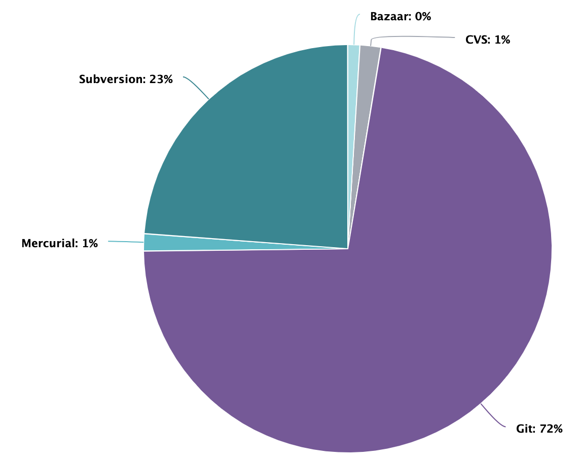
Git Intro
Why Git?
Source: https://www.openhub.net/repositories/compare

Slide 5


Centralized Project
Git Intro
All the changes need to go through the central unit.
If Dev A wants to bring some changes from Dev B, Dev B needs first to publish them into the centralized unit.
There is no direct connection between the decentralized terminals.
Dev A
Dev B
Dev C

Slide 6
Remote repository
Git Intro
Remote Repository:
Where the project lives.
It is remote because it is in the cloud
Dev A
Dev B
Dev C

Slide 7
Remote repository
Local repo
Local Repositories:
A copy of the remote repository that is stored in the computer of each developer.
Each developer will work on their local copy.
Dev A
Dev B
Dev C
Local Repo A
Local Repo B
Local Repo C

Slide 8
Remote repository
Upstream
Upstream
The connection between the local and the remote repository.
It indicates the local repository from which remote bring updates and publish changes.
Dev A
Dev B
Dev C
Local Repo A
Local Repo B
Local Repo C

Slide 9

Remote repository
Bringing changes
Pulling
Pull means bring changes in. That means that when Dev A pulls from the remote, he is bringing in the latest changes.
Dev A
Dev B
Dev C
Local Repo A
Local Repo B
Local Repo C

Slide 10
Remote repository
Publishing changes
Pushing
Pushing means publish local changes to the remote repository, making available from everybody else.
Dev A
Dev B
Dev C
Local Repo A
Local Repo B
Local Repo C

Slide 11
Remote repository
Adding nodes
Dev D
Cloning
Cloning a remote repository means to create a local repository (git init), set the connection to that remote and bringing in the changes (pull)
Local Repo D
Dev A
Dev B
Dev C
Local Repo A
Local Repo B
Local Repo C

Slide 12
Remote repository
Adding nodes
Dev D
Cloning
Init a local repository
Add some address as the remote
Pull from that remote
Local Repo D
Dev A
Dev B
Dev C
Local Repo A
Local Repo B
Local Repo C

Slide 13
Remote repository
Centralization
Dev D
Scenario: No internet
All developers can still keep on working, since they have a local copy.
They can upload their changes later: the connection would only be needed to update the remote.
Local Repo D
Dev A
Dev B
Dev C
Local Repo A
Local Repo B
Local Repo C

Slide 14

Remote repository
Centralization
Dev D
Scenario: the server that hosts the remote is down.
All developers can still keep on working, since they have a local copy.
They can upload their changes later.
Local Repo D
Dev A
Dev B
Dev C
Local Repo A
Local Repo B
Local Repo C

Slide 15




Providers
Some Remote Repositories Providers:

Slide 16
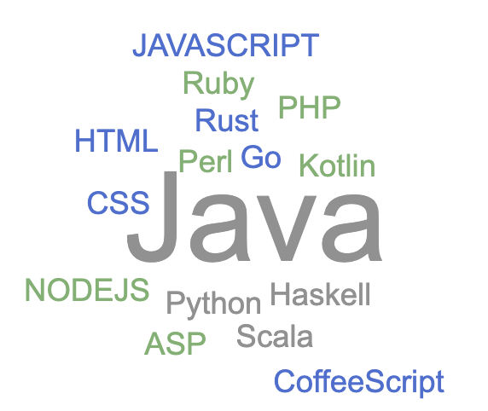
Supported Languages
What files does Git support?
Everything text based:
HTML, CSS, JS, Java, Python…
And many more.
What is not that useful for?
Interpreted files: pdf, psd, movies, images, music…
Why? Because it will be able to track the files, but not to read the changes inside.

Slide 17
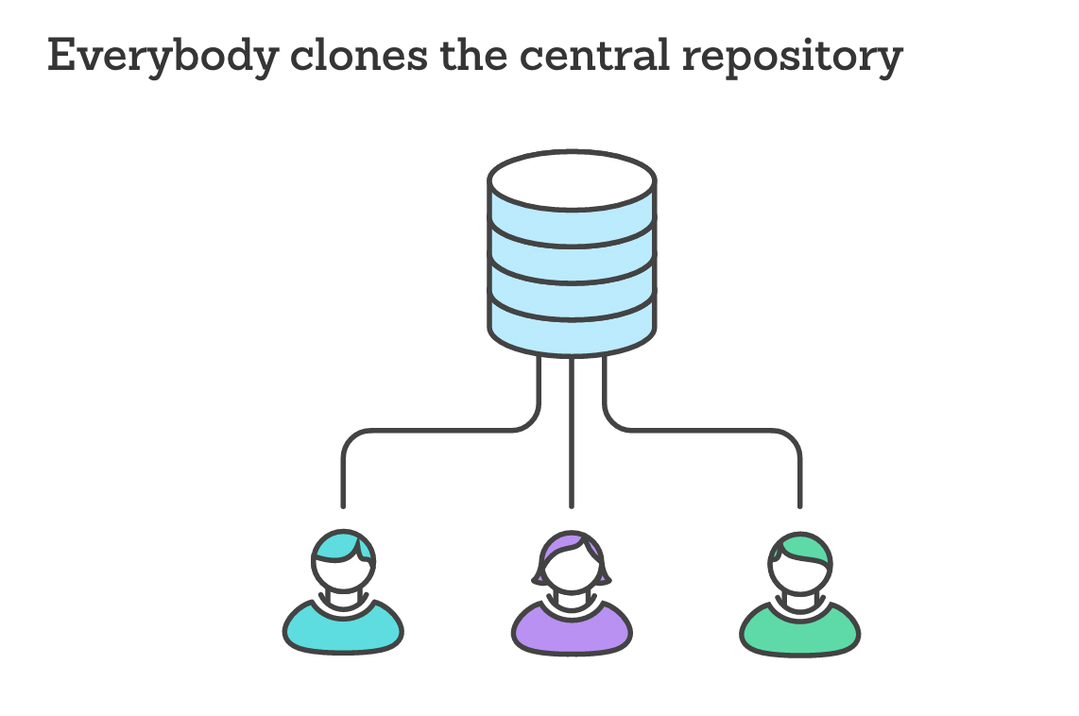
Working together
Dev A has cloned the repository.
Let’s focus on the local repository when Dev A makes changes.
And how the repositories work.
Central repository:
Lives in the cloud.
Everybody gets a copy of it at the beginning by ‘Cloning’ it.
All the developers do the changes locally.
To get updates the developers need to ‘pull’
To publish their local changes to the central repository they need to ‘push’
Everybody else can get to see the updates once they were pushed (they will need to pull)
Developers are constantly pulling and pushing changes to the central repository.
Dev A

Slide 18

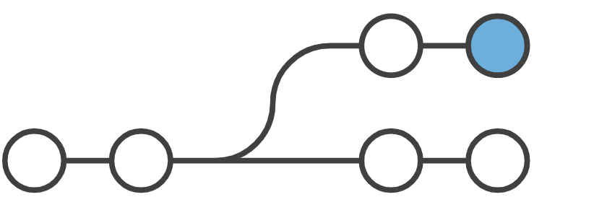
How git Works
How Git Works
A repository has at least one branch, but can have several more. Each branch, is a different version of your project.
This branches, can diverge at any moment, merge back again to another, etc.
Each branch has a name, and there is one branch that is considered the default. Usually is called main or master.
Changes are stored in commits.
Commits are snapshots of your files and directories of your project. This commits also have metadata: an ID, Author, descriptive message, and more.
main
One branch, linear workflow
feature
main
Two branches, feature bifurcates from the main branch and keeps a different history.

Slide 19
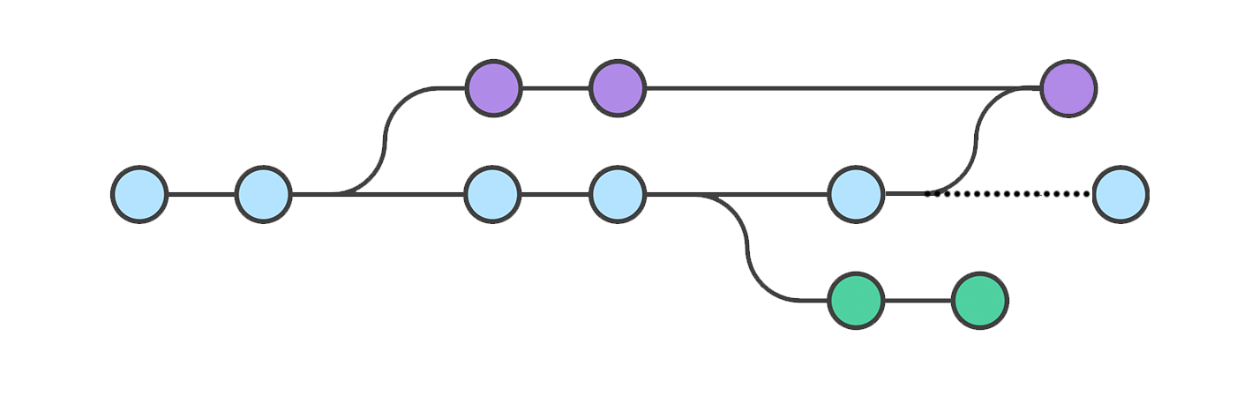
Branches
Branches
Each developer can work in a separate branch.
Their local branch will be paired with the remote’s branch.
Dev1: His local branch feature 1, pairs with the remote branch feature1
Dev2: His local branch feature 2, pairs with the remote branch feature2
Dev1, if he wants, can ‘switch’ his working branch to feature2, or two main at any point and still do changes in another branch.
feature1
F1A
F1B
F1C
main
M1
M2
M3
M4
M5
M6
F2A
F2B
feature2

Slide 20
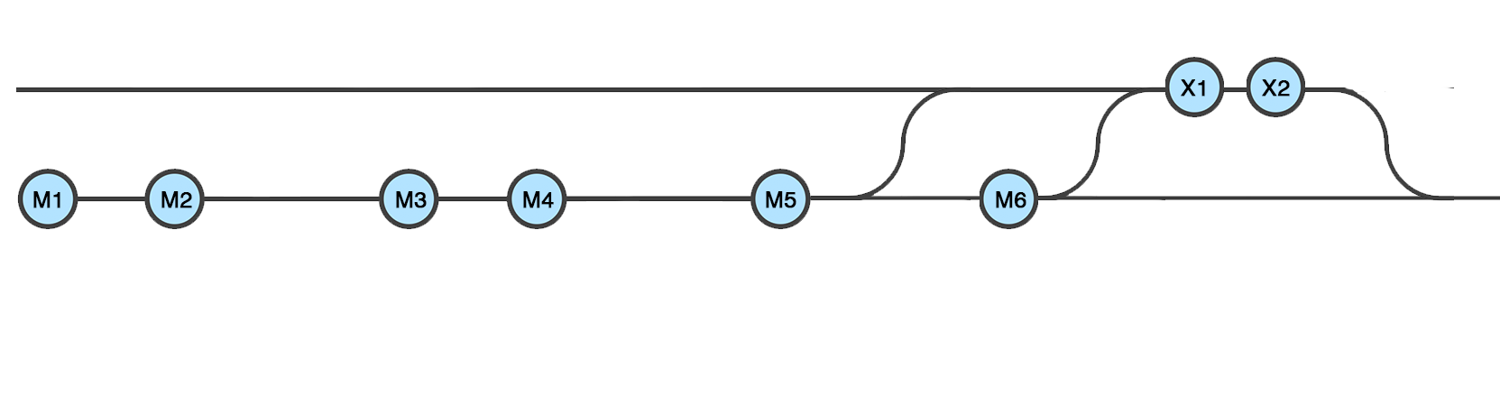
Local and remote
Dev 1 has cloned the project.
He switches to the proper branch where he needs to work on (or creates a new one from the defatult branch)
He asks for the latest changes (pulls)
Works, and creates two commits: X1, X2.
Those commits doesn’t exist in the remote yet, so he needs to publish them: push.
feature1 (local)
push
pull
pull
feature1 (remote)
Dev 1 is working on his feature1 branch, which its upstream is set to trach the remote/feature1. The remote holds commits that Dev1 doesn’t have, so he needs to pull them. When he works and commits, to publish those updates (commits) he needs to push them to the remote.

Slide 21
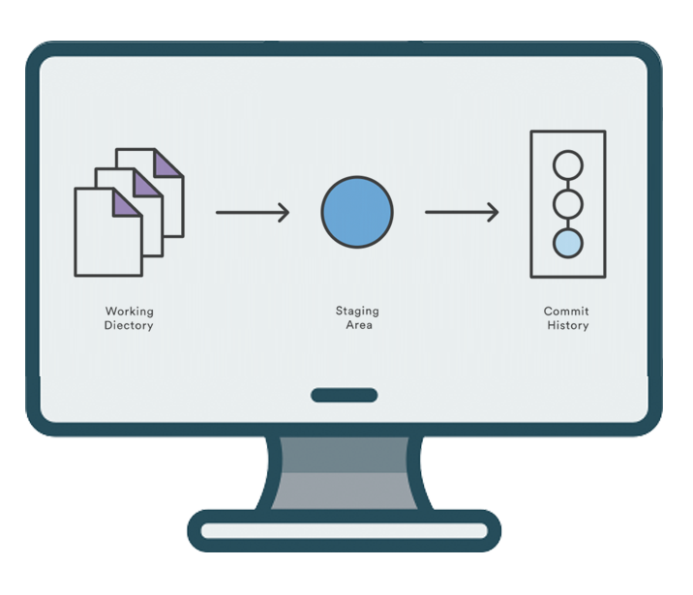
The staging areas
When working locally, there are 3 different areas that might suffer changes:
All the changes that any of the Developers would do, in order to be stored, they need to go through 3 stages:
Working directory
The index or Staging Area
Commit
clone/pull
push
The developer once he clones/pulls from the repository, can work locally without modifying the source code. Those modifications, can be part of 3 different stages.

Slide 22
The staging areas
Areas:
Working directory: where all the changes are made. If no changes are made, the working directory tree is said to be ‘clean’
Staging Area: The changes that you choose to commit, are moved to the ‘staged area’. Only this ‘staged’ changes are going to be committed.
Commit: Snapshot that stores the content of the Staging area with a comment. This commit gets a unique ID or ‘SHAS’
clone/pull
push

Slide 23
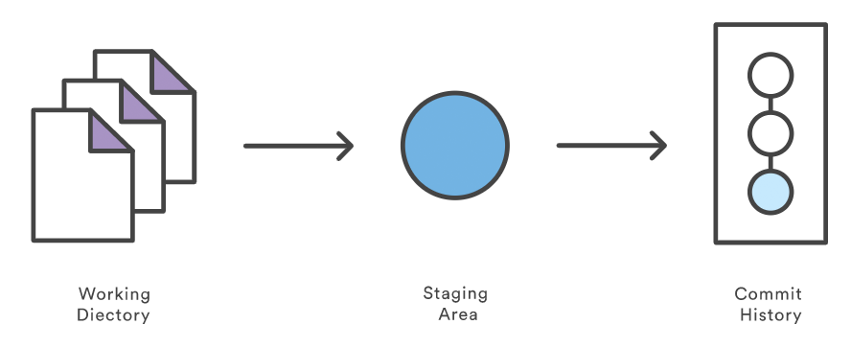
The staging areas
git add
git commit
git pull
git push

Slide 24

The staging areas
git add
git commit
git pull
git push
git checkout --
git reset --
Afterwards creating a commit, the process starts again: The working directory now is clean.

